Slide 1
Nervous system
For Notes
© Gnature with Gnat 2018

Slide 2
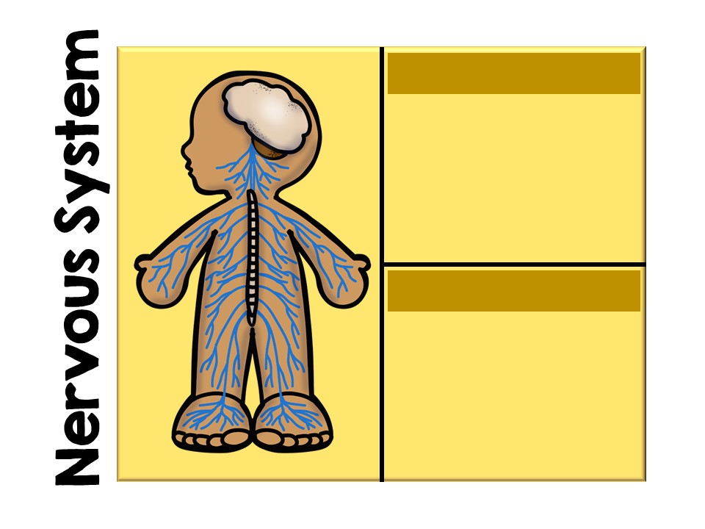
Function:
Detects impulses from the senses; control center.
Major Organs:
-Brain
-Spinal cord
-Senses
-Nerves
© Gnature with Gnat 2018

Slide 3
Nerves
© Gnature with Gnat 2018

Slide 4
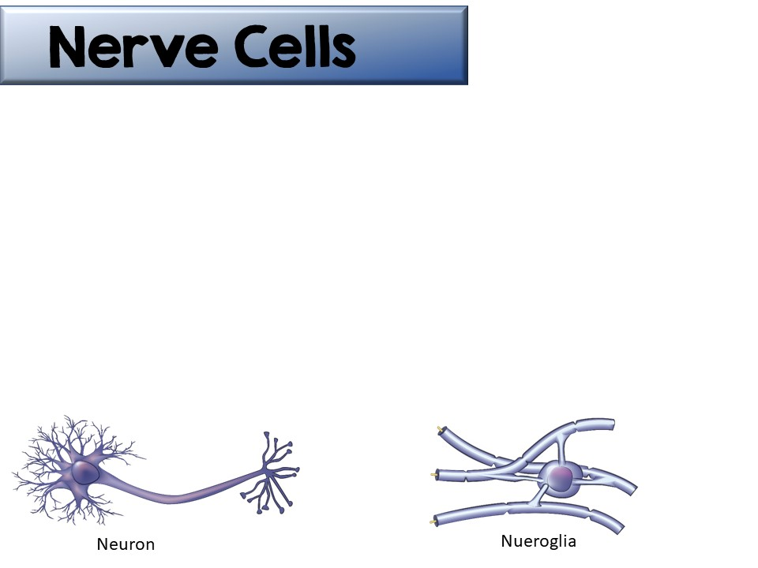
Nerve cells pass impulses throughout the body.
There are 2 major types of nerve cells:
  Neurons (make up 10% of the nervous system)
  Neuroglia (“nerve-glue”, make up 90% of the nervous system)
Neuroglia
© Gnature with Gnat 2018

Slide 5
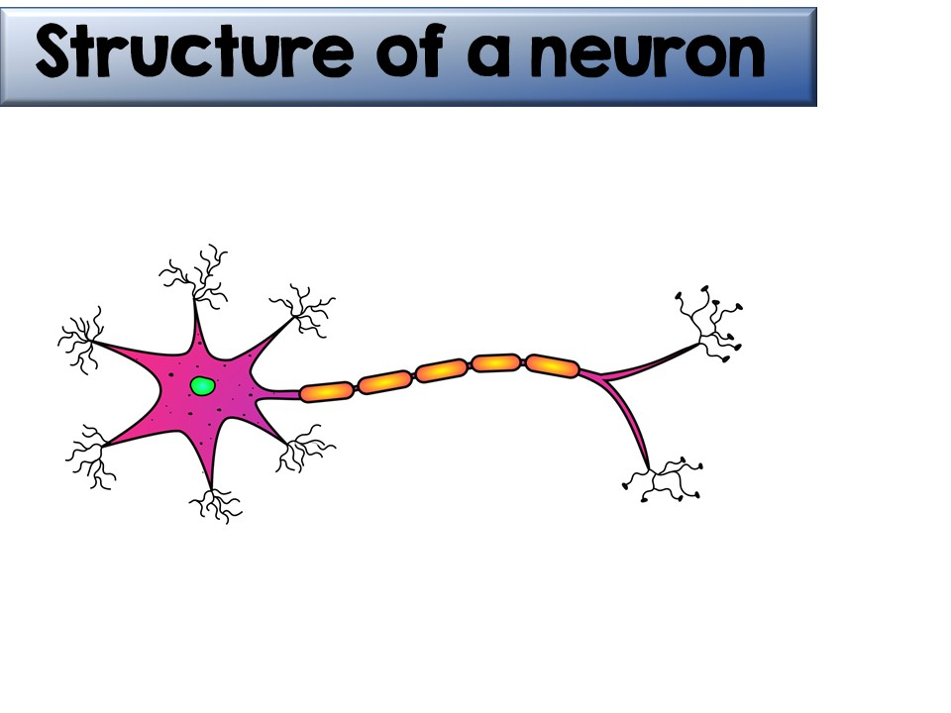
Structure of a neuron
Dendrites: receive the nerve impulse from the senses or another neuron
Axon: passageway for nerve impulse after cell body; end in axon terminals
Myelin sheath: insulates the axon. Produced by the Schwann cells.
Between the myelin sheath is the Nodes of Ranvier. Nerve impulses jump from node to node, which increases the speed of the impulse.
Cell Body: contains the nucleus; transmits impulse to the axon
© Gnature with Gnat 2018

Slide 6
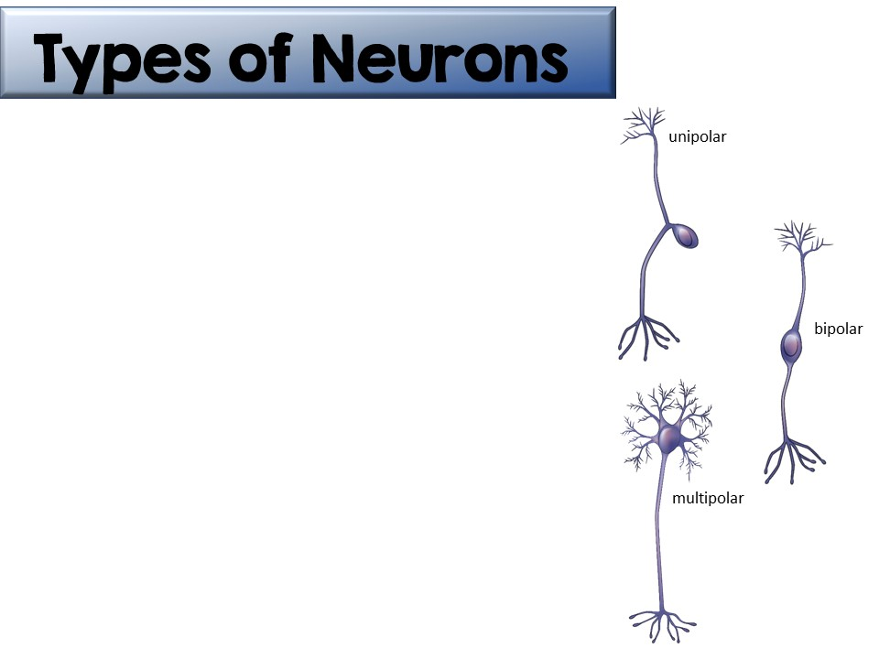
Neurons are classified by the number of processes (extensions) from the cell body.
  Unipolar neurons have one process
  Bipolar neurons have two processes
  Multipolar neurons have many processes (usually several dendrites and one axon)
© Gnature with Gnat 2018

Slide 7
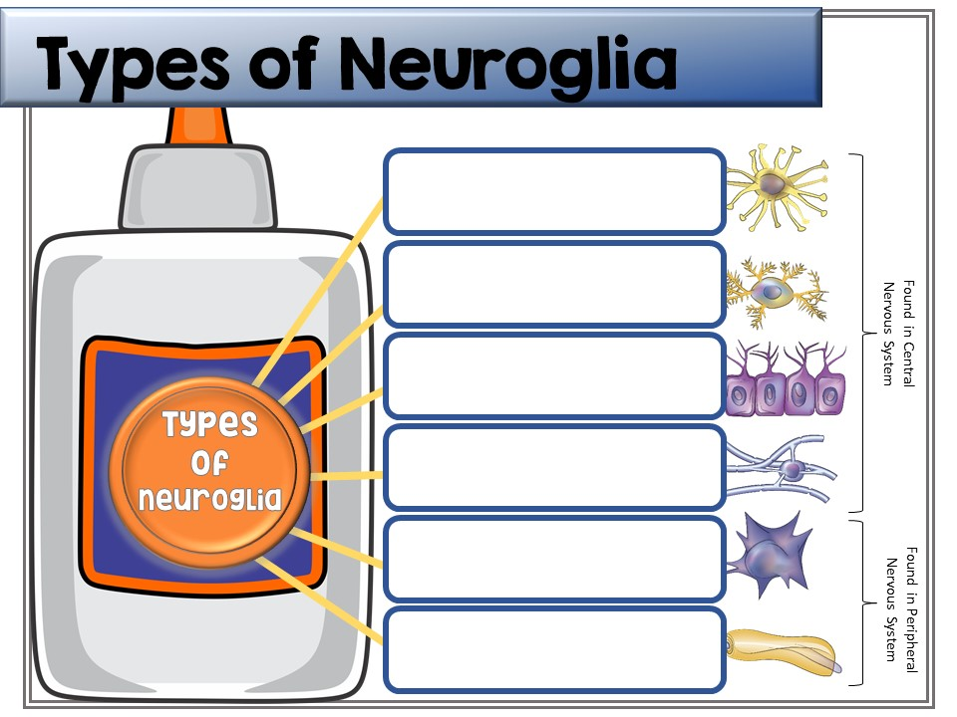
Astrocytes: Support and anchor neurons to surrounding capillaries
Microglia: Provides immune response to Central Nervous System
Ependymal cells: Secrete and circulate cerebrospinal fluid
Oligodendrocytes: Provide myelin insulation to neurons in the CNS
Satellite cells: Support and anchor neurons in the Peripheral Nervous System
Schwann cells: Provide myelin insulation to neurons in the PNS
© Gnature with Gnat 2018

Slide 8

For more information about neurons & neuroglia, click on this video link.
© Gnature with Gnat 2018

Slide 9
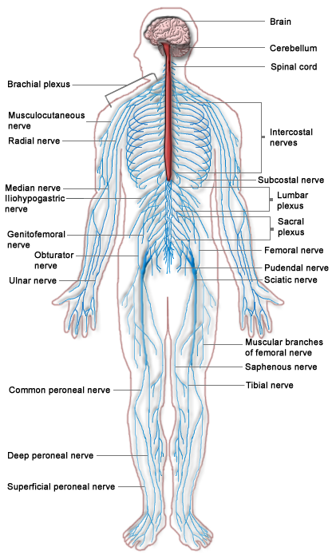
Organization of the Nervous System
The nervous system is divided into
  Central nervous system (CNS), which consists of the brain and spinal cord
  Peripheral nervous system (PNS), which consists of the other nerves
    Cranial nerves- originate in the brain
    Spinal nerves- originate in the spinal cord
The peripheral nervous system is then further divided.
© Gnature with Gnat 2018

Slide 10
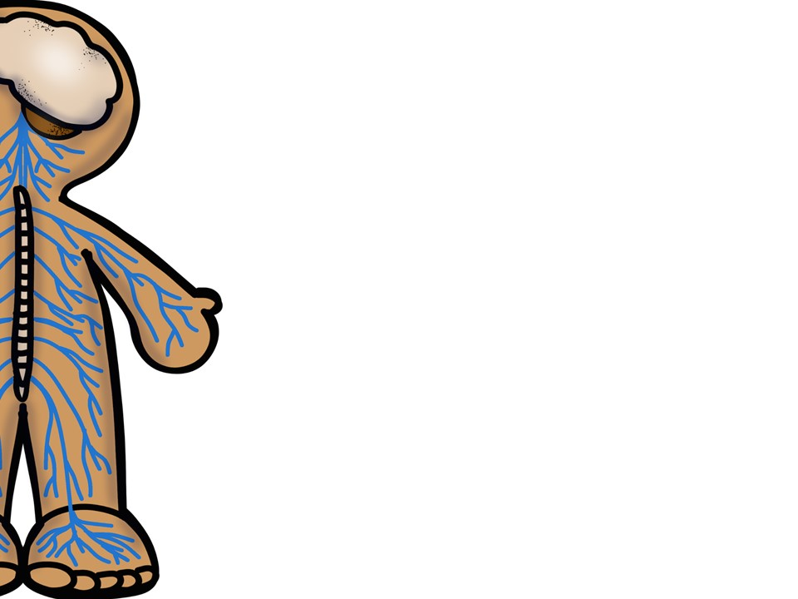
Peripheral Nervous System (PNS), comprised of all nerves not in brain or spinal cord
Sensory (Afferent) Division- sends impulses from the senses to the CNS
Motor (Efferent) Division- sends impulses from the CNS to the muscles and glands
Autonomic Nervous System- involuntary muscle control
Somatic Nervous System- voluntary muscle control
Sympathetic Division- used in emergency situations (“fight or flight”)
Parasympathetic Division- reduces sympathetic response and provides resting functions such as digestion and urination
© Gnature with Gnat 2018

Slide 11
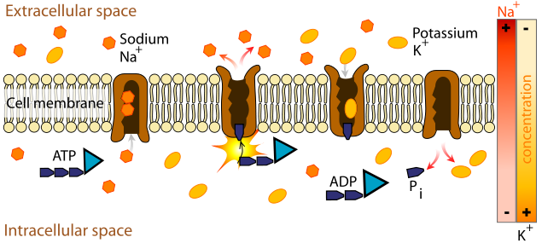
Nerve Impulses
A nerve impulse is an electrical signal that travels along the neuron.
A sodium-potassium pump (transport of ions that requires energy) creates an electrical potential along the neuron in which the cell is negatively charged and the environment is positively charged. This is called the resting potential.
© Gnature with Gnat 2018

Slide 12
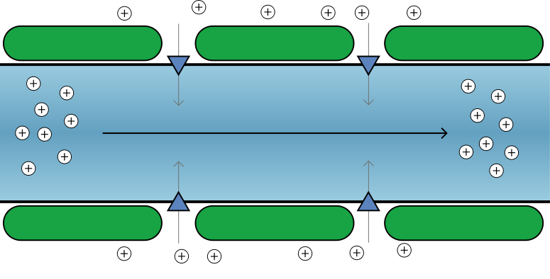
Nerve Impulses
When the neuron is stimulated, either by the environment or another neuron, sodium rushes into the neuron and quickly reverses the charges. This is called the action potential.
This process quickly moves down the length of the neuron.
As the impulse passes, sodium again is pumped out and the resting potential returns.
© Gnature with Gnat 2018

Slide 13
Watch the process at work by clicking on this video link.
© Gnature with Gnat 2018

Slide 14
1- Impulse arrives and threshold is met
2- Voltage-gated Na+ channels are opened and Na+ enters the cell
3- Voltage-gated K+ channels are opened and K+ leaves the cell; Na+ channels begin to rest
4- Voltage-gated K+ channels are still open; Na+ channels are in the resting state
5- Na+/K+ pump restores original levels of voltage in cell
Na+
K+
K+
AXON
Na+
Na+
K+
Direction of impulse
K+
Na+
K+
K+
Na+
K+
K+
+40
3
0
2
Depolarization
Repolarization
Action
Membrane Voltage (mV)
Potential
-55
Threshold
Failed initiations
-70
4
Resting state
1
Refractory Period
5
© Gnature with Gnat 2018

Slide 15
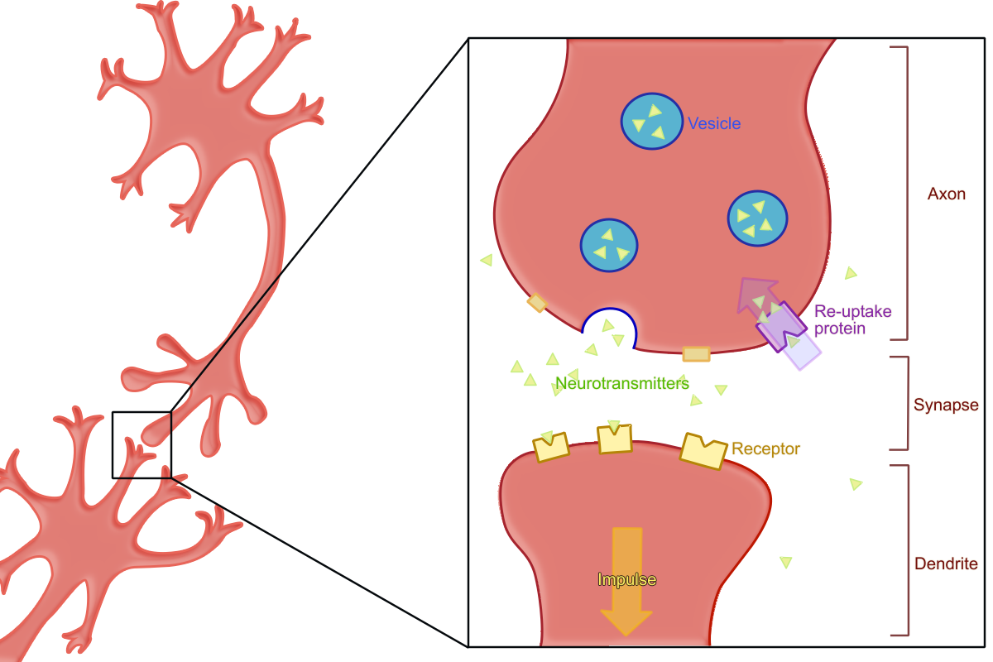
Nerve Synapse: Continuing the Impulse
Where 2 neurons meet is a synapse.
The 2 neurons do not touch. The space between them is called the synaptic cleft.
Axon
Synaptic cleft
Dendrite
© Gnature with Gnat 2018

Slide 16
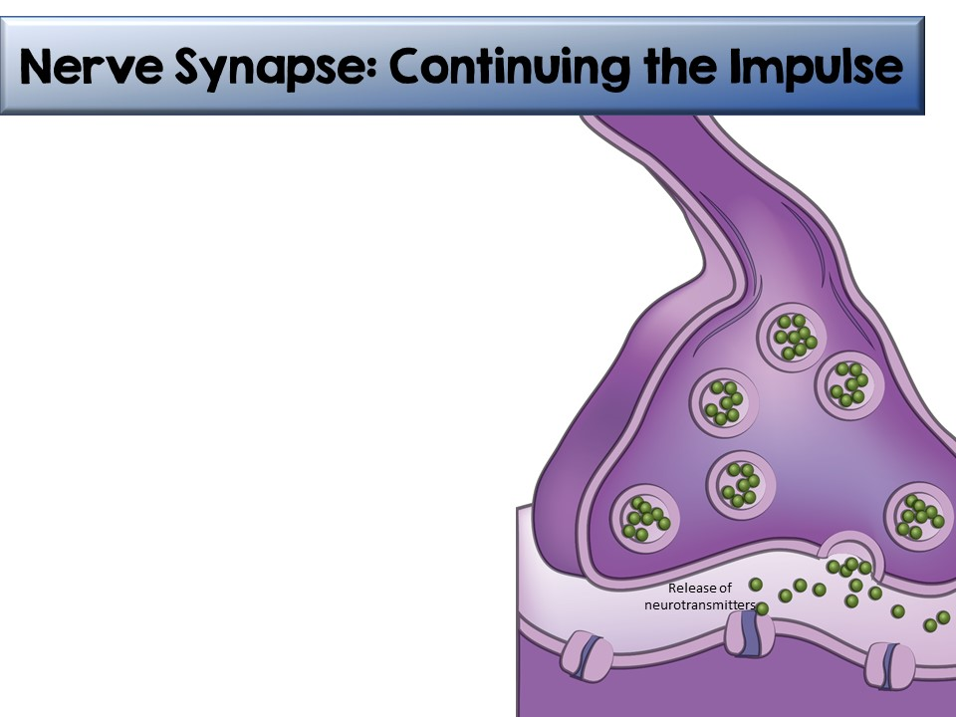
As the impulse reaches the axon terminal, it can not cross the gap.
The impulse stimulates neurotransmitters to be released across the synaptic cleft.
These neurotransmitters cause the channels to open in the next neuron, continuing the action potential from one neuron to the next.
Release of neurotransmitters
© Gnature with Gnat 2018

Slide 17
Overview of Synaptic Transmission
1
2
3
4
Action potential arrives at presynaptic terminal
Ca²⁺ channels open on presynaptic terminal
Synaptic vesicles release neurotransmitters
Neurotransmitters bind to receptors on the postsynaptic neuron
5
Na⁺ channels open on the postsynaptic neuron
Impulse continues
© Gnature with Gnat 2018

Slide 18
The Brain
© Gnature with Gnat 2018

Slide 19
Central Nervous System
The brain and spinal cord make up the Central Nervous System (CNS).
These structures are protected by three layers of connective tissue called the meninges.
  Dura mater- thick, tough layer
  Arachnoid membrane- thin, cobweb-like layer
  Pia mater- thin layer containing lots of blood vessels
© Gnature with Gnat 2018

Slide 20
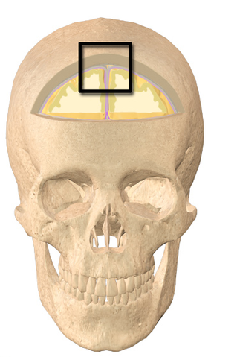
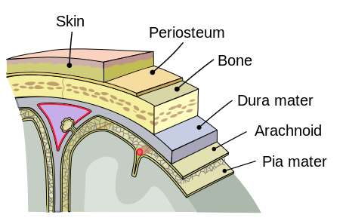
© Gnature with Gnat 2018

Slide 21
Central Nervous System
Between the arachnoid layer and the pia mater is the cerebrospinal fluid (CSF).
  The cerebrospinal fluid protects the brain by preventing the it from contacting the skull.
  It also maintains the blood-brain barrier, which controls homeostasis for the brain and prevents infection.
The CSF is produced in spaces within the brain called ventricles.
  CSF is constantly being produced, circulated and reabsorbed within these ventricles.
© Gnature with Gnat 2018

Slide 22
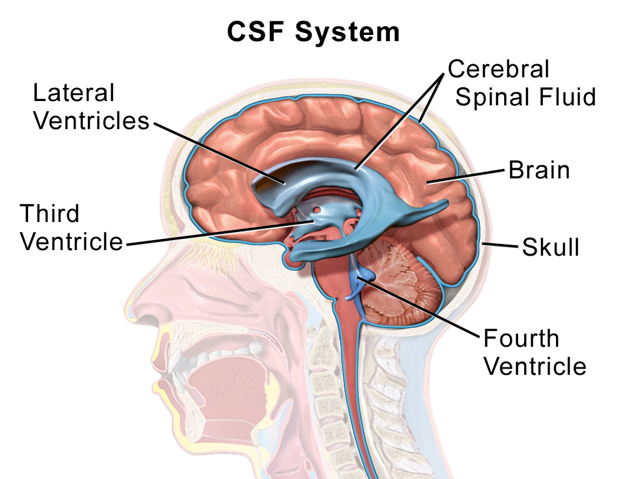
By BruceBlaus. When using this image in external sources it can be cited as:Blausen.com staff (2014). "Medical gallery of Blausen Medical 2014". WikiJournal of Medicine 1 (2). DOI:10.15347/wjm/2014.010. ISSN 2002-4436. [CC BY 3.0 (https://creativecommons.org/licenses/by/3.0)], from Wikimedia Commons
© Gnature with Gnat 2018

Slide 23
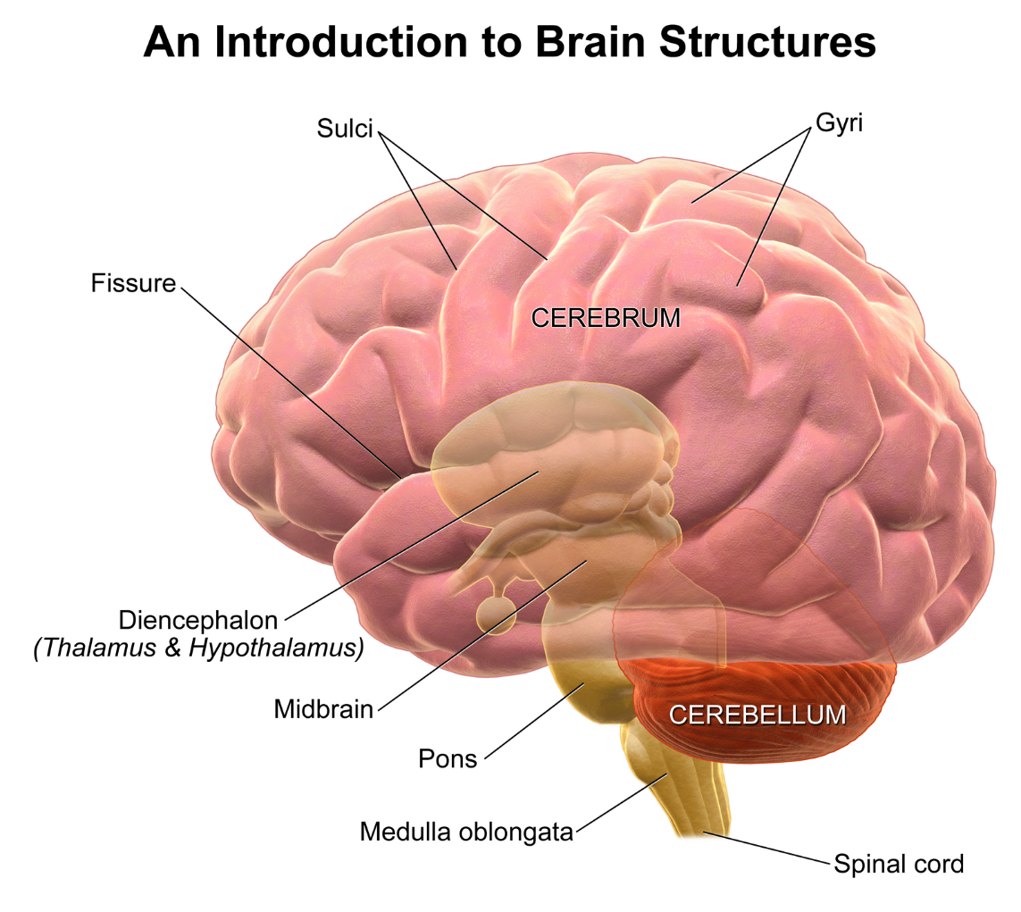
Structure of the Brain: The Cerebrum
Largest part of brain
Divided into 2 hemispheres
Outer cerebral cortex= “gray matter,” made of cell bodies & dendrites
  Controls conscious activities
Inner cerebral medulla= “white matter,” made of myelinated axons
© Gnature with Gnat 2018

Slide 24
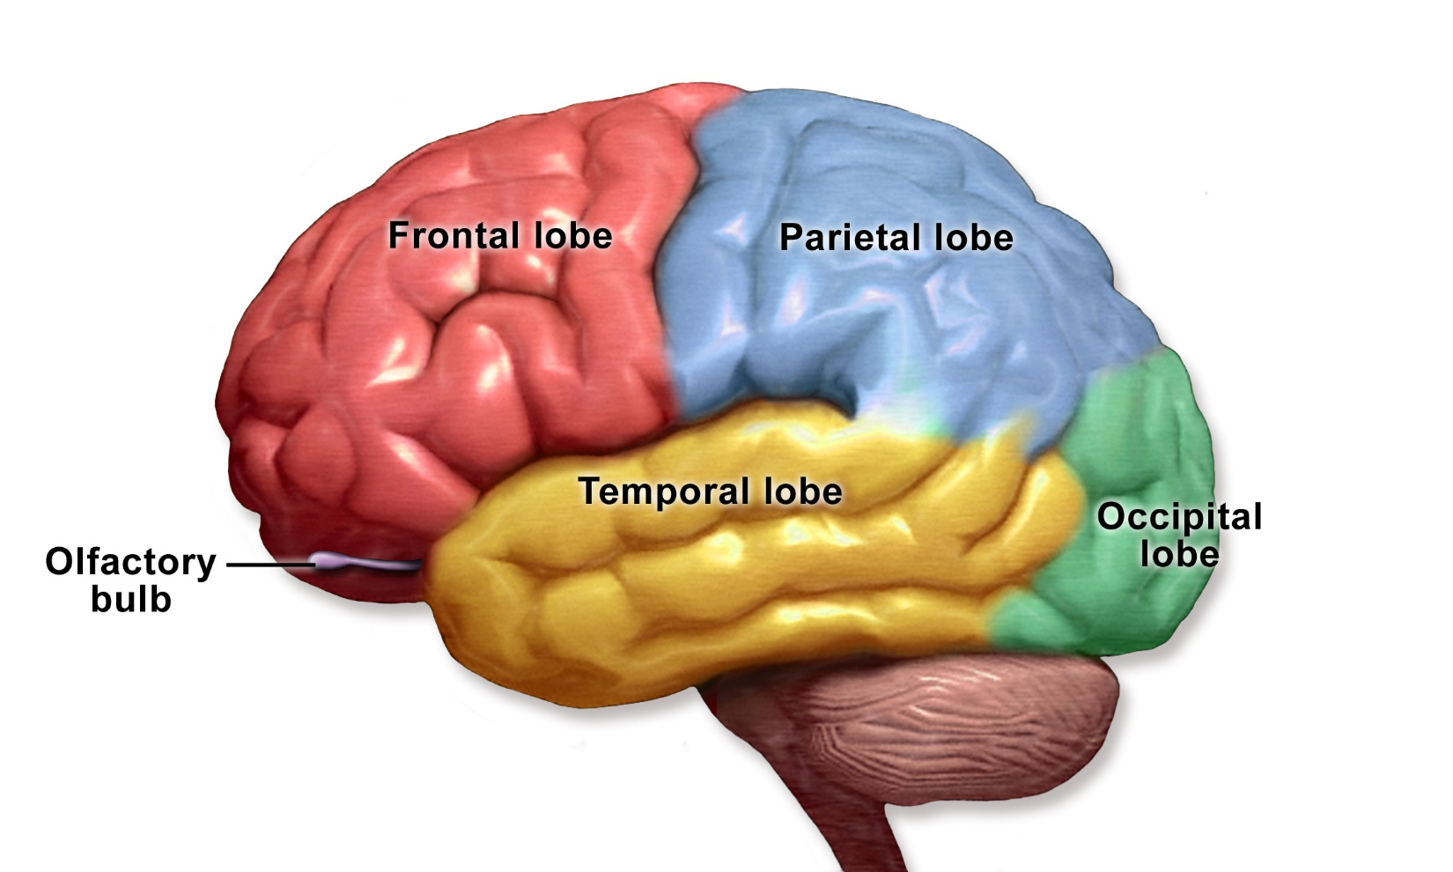
Structure of the Brain: The Cerebrum
The cerebrum is divided into 4 lobes, based on their functions. They are named for the parts of the skull protecting them.
© Gnature with Gnat 2018

Slide 25
Cerebrum: Frontal Lobe
The frontal lobe controls:
  Voluntary movements (walking)
  Reasoning & decision-making
  Memory
  Ability to predict consequences of actions
  Planning
  Verbal communication
© Gnature with Gnat 2018

Slide 26
Cerebrum: Parietal Lobe
The parietal lobe controls:
  Sensations
  Visual-spatial processing
  Body position
© Gnature with Gnat 2018

Slide 27
Cerebrum: Occipital Lobe
The occipital lobe controls:
  Visual processing- vision & memory of objects
© Gnature with Gnat 2018

Slide 28
Cerebrum: Temporal Lobe
The temporal lobe controls:
  Memory
  Comprehension & pronunciation of words
  Sensations of smell and sound
  Emotional association of memories
© Gnature with Gnat 2018

Slide 29
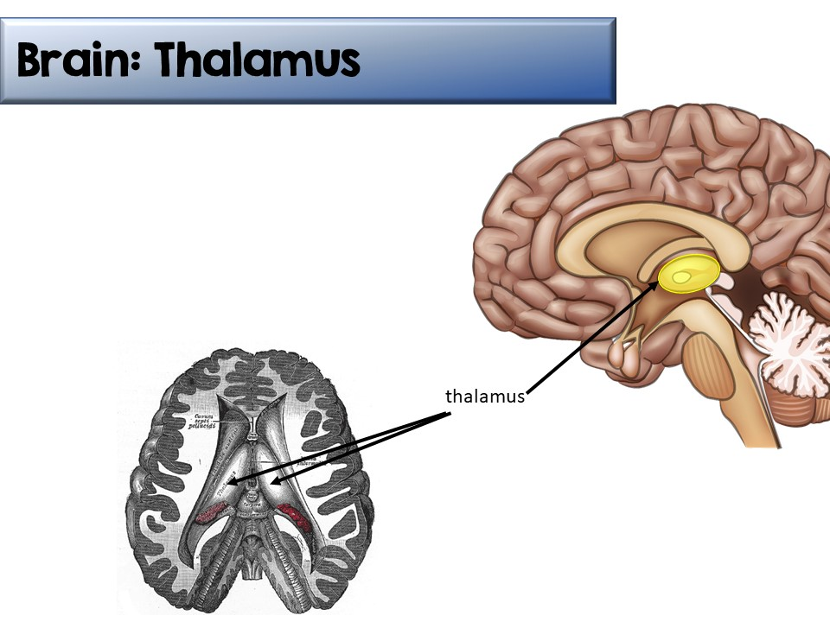
2 bulb-shaped halves in the center of the brain
Relays sensory impulses to the cerebral cortex for processing and sorting
© Gnature with Gnat 2018

Slide 30
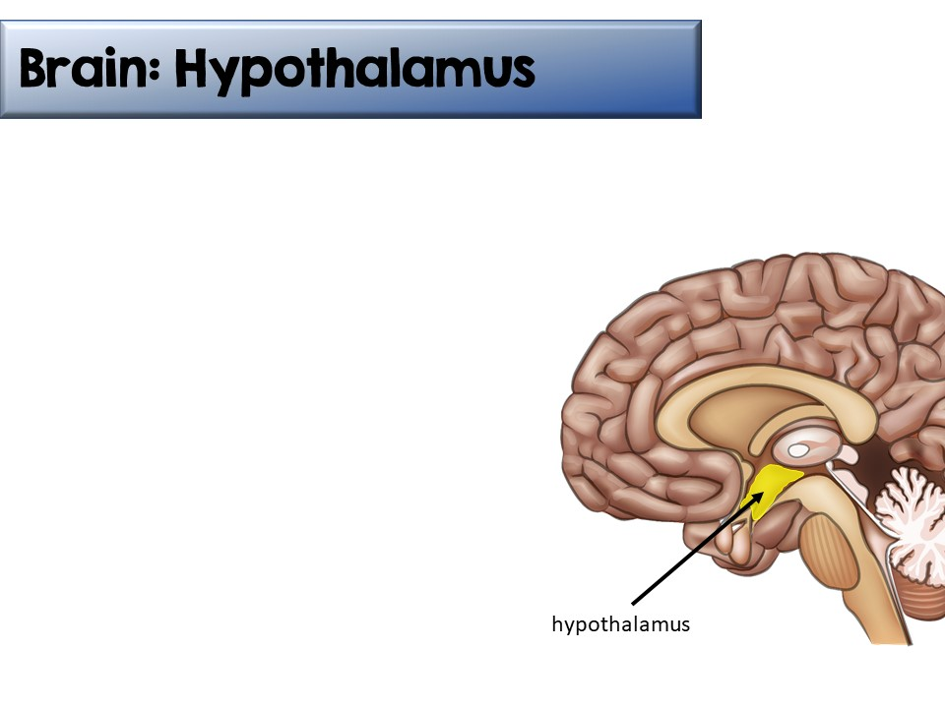
Tiny portion of the brain near the thalamus (hypothalamus= “below thalamus”)
Controls hormones released by pituitary gland
  Often called the “master endocrine gland”
Responsible for autonomic processes such as body temperature, hunger, thirst, sleep, and blood volume
© Gnature with Gnat 2018

Slide 31
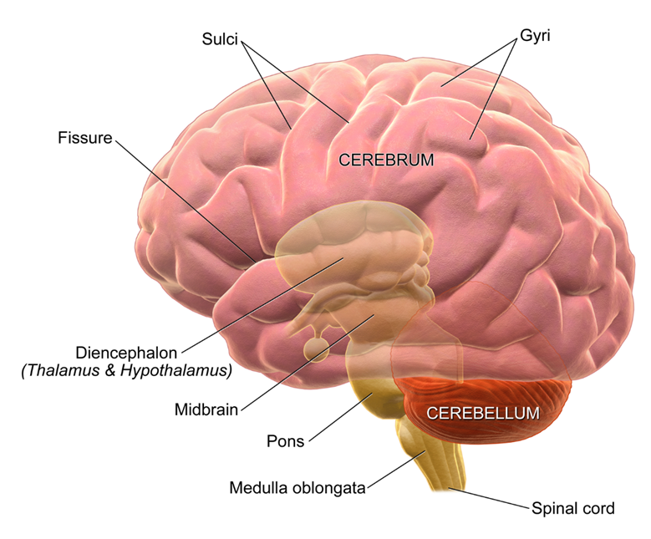
Brain: Brainstem
The brainstem is located between the cerebrum and the spinal cord.
It is broken into three regions:
  Midbrain
  Pons
  Medulla Oblongata
© Gnature with Gnat 2018

Slide 32
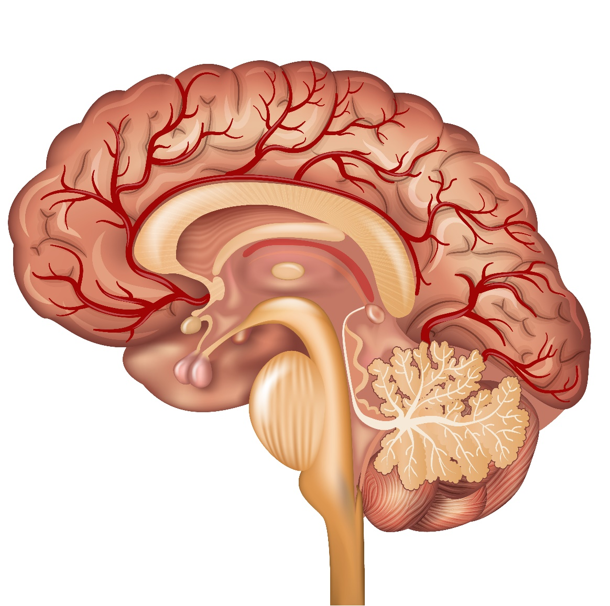
Brainstem: Midbrain
Also known as mesencephalon
Relays information to cerebrum
Controls body movements and posture
midbrain
© Gnature with Gnat 2018

Slide 33
Brain: pons
Brainstem: Pons
“Pons”= “bridge”
Almost completely made of white matter that links the cerebral cortex and the cerebellum
Carries information from one side of the brain to the other
Central control of breathing
pons
© Gnature with Gnat 2018

Slide 34
Brain: Medulla oblongata
Brainstem: Medulla Oblongata
Located just above the spinal cord.
Transmits impulses between the spinal cord and the brain.
Controls blood pressure, heart rate, swallowing, and coughing.
medulla oblongata
© Gnature with Gnat 2018

Slide 35
Brain: cerebellum
Brain: Cerebellum
Second largest part of brain
Near back of skull
Responsible for coordinating the movements directed by the cerebrum so that they are graceful and efficient.
All involuntary
After practicing a new sport or movement, the cerebellum aids in “muscle memory”.
© Gnature with Gnat 2018

Slide 36
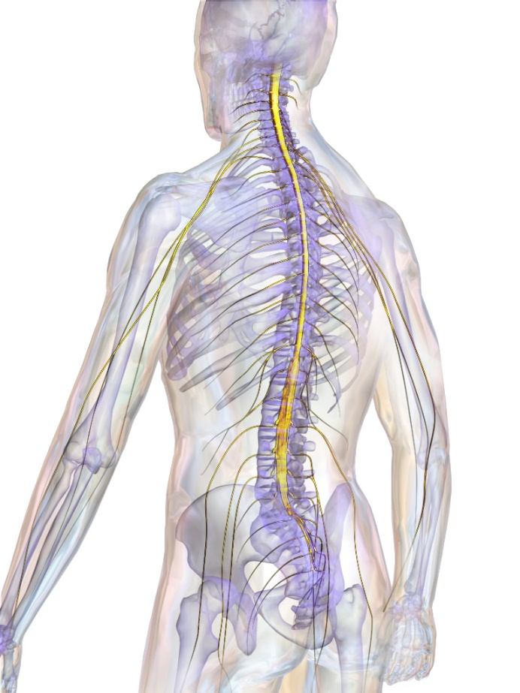
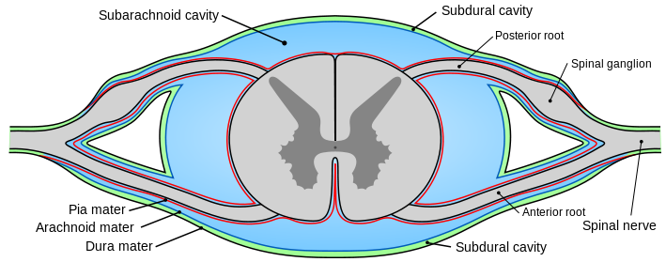
Spinal Cord
By BruceBlaus [CC BY 3.0 (https://creativecommons.org/licenses/by/3.0)], from Wikimedia Commons
Extends from the medulla oblongata
31 pairs of spinal nerve branch out from the spinal cord, connecting it to all parts of the body.
Relays impulses from the peripheral nervous system to the brain.
A cross-section of the spinal cord has a “butterfly” of gray matter surrounded by white matter.
© Gnature with Gnat 2018

Slide 37
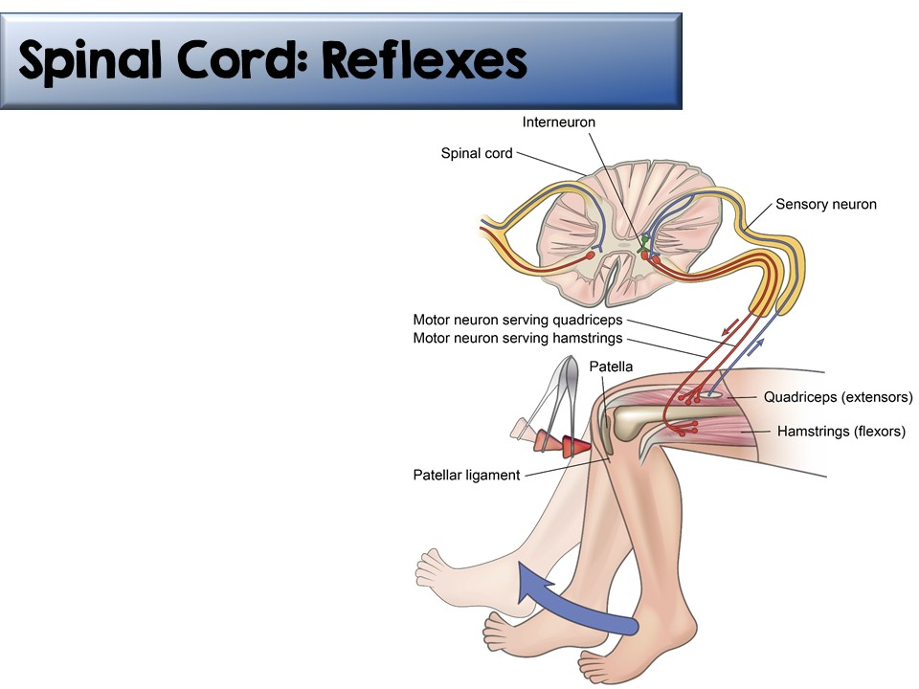
A reflex arc is caused by a stimulus, transmitted to the spinal cord by a sensory nerve, then back to the muscles through a motor nerve without first being transmitted to the brain.
© Gnature with Gnat 2018

Slide 38

Common Diseases of the Nervous System
Cerebral palsy
Coma
Encephalitis
Epilepsy
Headache
Hydrocephalus
Mental illness
Meningitis
Multiple sclerosis
Parkinson’s disease
Phobia
Senility
Shock
© Gnature with Gnat 2018

Slide 39
Senses
© Gnature with Gnat 2018

Slide 40
the senses
The Senses
All sensory organs contain sensory receptors- dendrites that react to a certain external or internal stimulus.
There are 5 major types of sensory receptors:
  1. Mechanoreceptors (touch)
  2. Thermoreceptors (temperature variations)
  3. Pain receptors
  4. Chemoreceptors (chemicals)
  5. Photoreceptors (light)
Each sensory organ has one or more of these receptors.
© Gnature with Gnat 2018

Slide 41

Senses: Touch
The impulses produced in the skin are called cutaneous sensations. These sensations include touch, heat, cold, pressure, & pain.
These receptors are not equally distributed throughout the body. Some body parts are more sensitive than others.
© Gnature with Gnat 2018

Slide 42
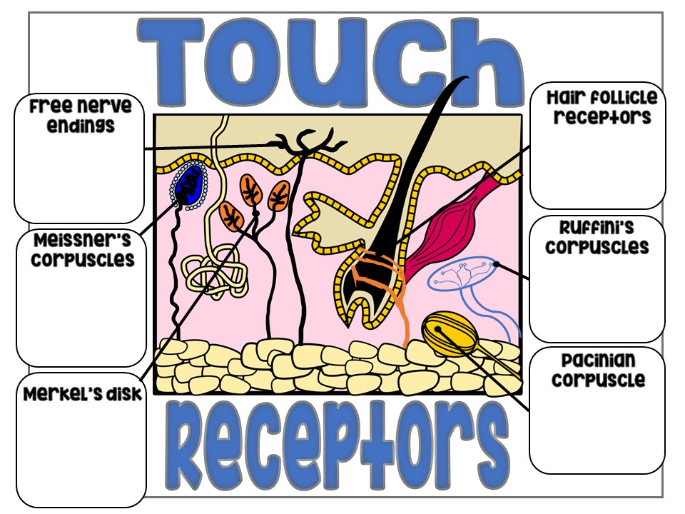
Sense pain, temperature, touch, and pressure
Detect movement of hair
Detect deep pressure and stretching of skin
Encapsulated nerve endings found in hairless skin that detect light touch
Encapsulated nerve endings that detect deep pressure and vibrations
Detect light touch and pressure within epidermis
© Gnature with Gnat 2018

Slide 43
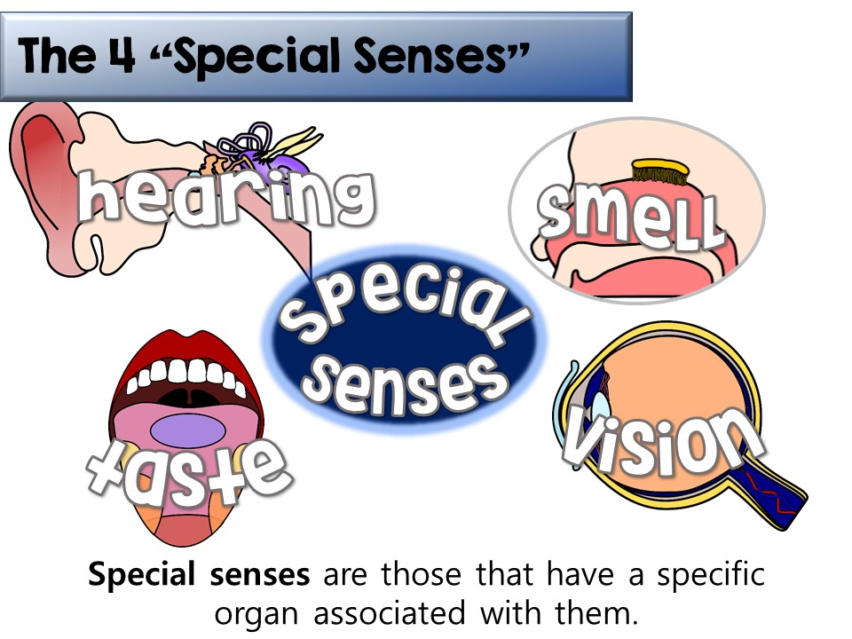
© Gnature with Gnat 2018

Slide 44
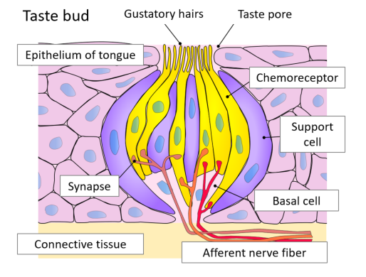
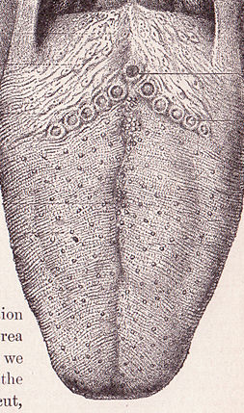
The senses: Taste
Senses: Taste
The tongue is filled with bumps called papillae. Many of these papillae contain taste buds, which contain chemoreceptors.
These chemoreceptors bind to certain molecules and then initiate an impulse through the nerves.
Children have more taste buds than adults, so they taste more strongly. Also, a child’s taste buds are replaced more often than an adult’s. This is why children become “less picky” as they grow.
Foliate papillae
Circumvallate
papillae
Filiform & fungiform papillae
Cross section of a taste bud
© Gnature with Gnat 2018

Slide 45
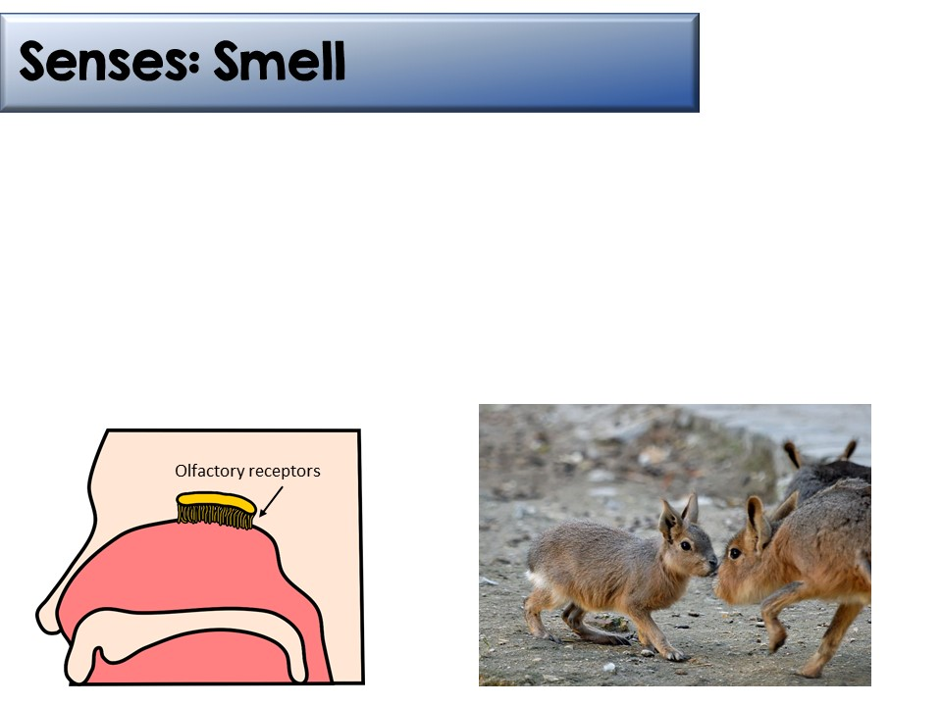
The sense of smell is closely related to the sense of taste.
Olfactory receptors in the upper nasal cavities help to distinguish thousands of different molecules.
“Sniffing” helps to bring these molecules into contact with the olfactory receptors.
When olfactory receptors contact a substance continually, they become insensitive to the smell. This is called accommodation.
© Gnature with Gnat 2018

Slide 46
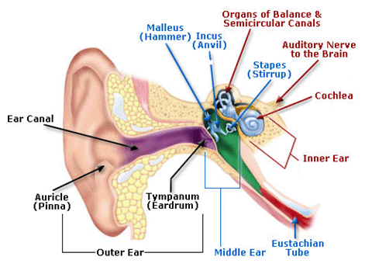
Senses: Hearing
The structures of the ear all work together to collect and transfer sound vibrations to the auditory nerve.
© Gnature with Gnat 2018

Slide 47
Senses: Hearing
Sound waves are collected by the auricle (outer ear) and are passed through the external auditory canal.
The sound waves then vibrate the tympanic membrane (eardrum).
Sound waves then travel through the middle ear, a set of 3 tiny, jointed bones: malleus, incus, and stapes
  These are commonly known as the hammer, the anvil, and the stirrup.
  They amplify the sound waves to the inner ear through a membrane called the oval window.
Watch a video of the ear working:
https://www.youtube.com/watch?v=dCyz8-eAs1I
© Gnature with Gnat 2018

Slide 48
Senses: Hearing
The inner ear contains the cochlea, a bony snail-shaped structure containing membranes filled with fluid.
As the tiny hair cells (stereocilia) inside the cochlea vibrate, they depolarize the ends of the nerve cells, which begins an action potential, transferring the impulse to the brain through the auditory nerve.
The brain registers these impulses as sounds.
© Gnature with Gnat 2018

Slide 49
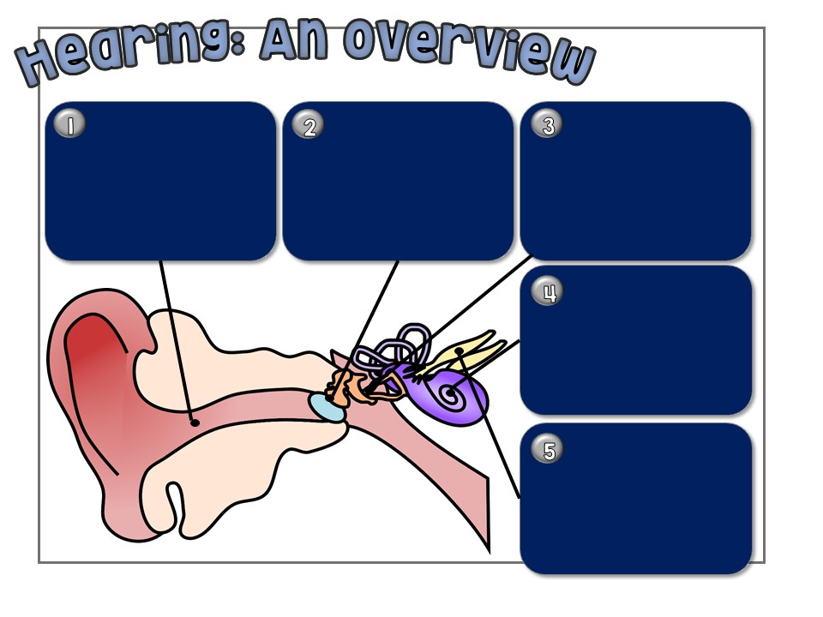
Sound waves enter your outer ear and travel down the ear canal.
The tympanic membrane (eardrum) vibrates and sends the vibrations to the tiny bones in the middle ear (ossicles).
The malleus, incus, and stapes amplify the vibrations and send them to the inner ear.
Within the cochlea, the organ of Corti is filled with stereocilia that transmit the mechanical energy of sound waves into electrical signals.
The electrical impulse travels through the auditory nerve towards the brain, which interprets the impulse as sounds.
© Gnature with Gnat 2018

Slide 50
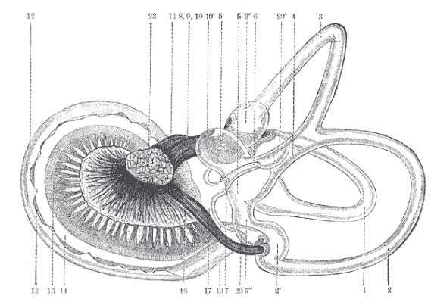
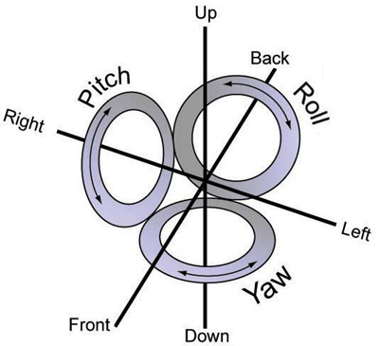
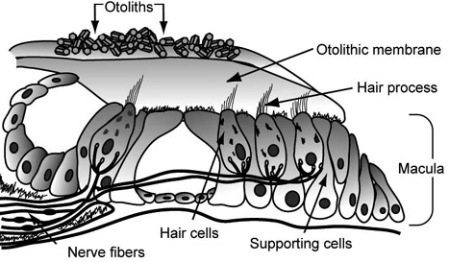
Senses: Balance
In addition to hearing, the ear also helps us with balance.
Three semicircular canals are located above the cochlea and are situated at right angles to each other.
These canals are filled with fluid and lined with hair cells. Above the hair cells are tiny crystals called otoliths. When the head moves, these otoliths slide, stimulating the hair cells and sending an impulse to your brain.
Because the 3 canals are at right angles, all types of motion can be recognized.
© Gnature with Gnat 2018

Slide 51
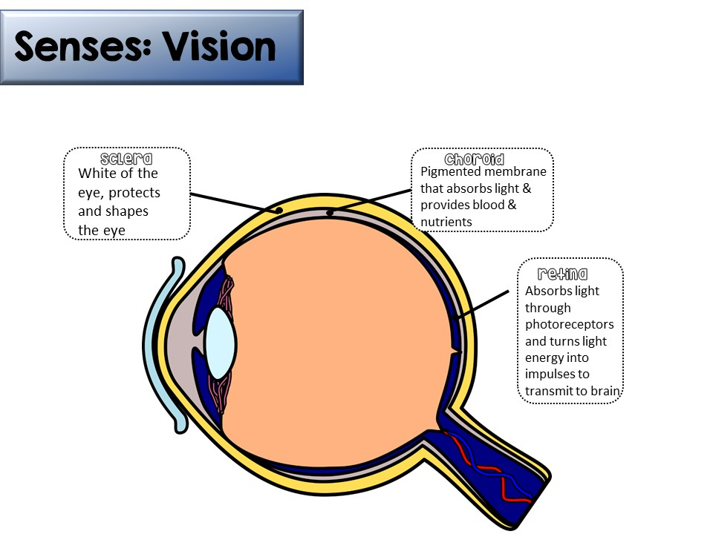
The eye is comprised of 3 tissue layers:
© Gnature with Gnat 2018

Slide 52
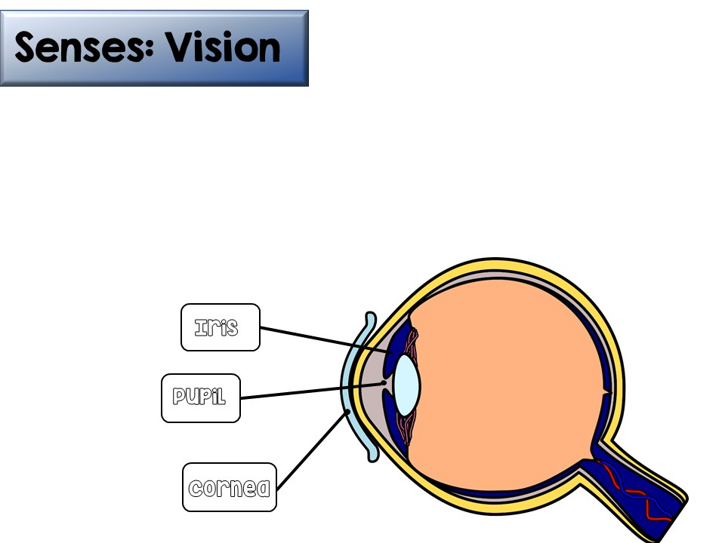
Cornea is made of thick, transparent tissue
  Function= allows light into the eye
The iris is located behind the cornea. It is the colored part of the eye.
  Function= works with pupil to regulate light entering the eye
Pupil is the opening in the center of the iris
  Function= muscles regulate the amount of light entering the eye
    Low light- pupil wide open
    High light- pupil nearly closed
© Gnature with Gnat 2018

Slide 53
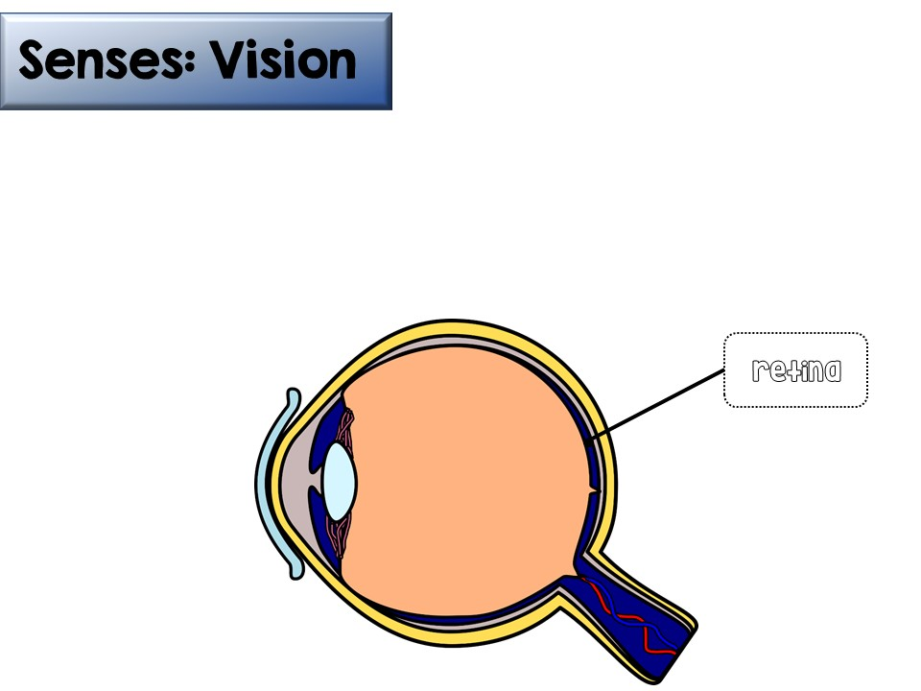
The retina, located in the back of the eye, contains thousands of photoreceptors.
There are two kinds of photoreceptors:
  Rods- distributed all over the retina. Responsible for vision in low light, extremely sensitive
  Cones- concentrated in center of retina. Responsible for detection of colors, less sensitive
© Gnature with Gnat 2018

Slide 54
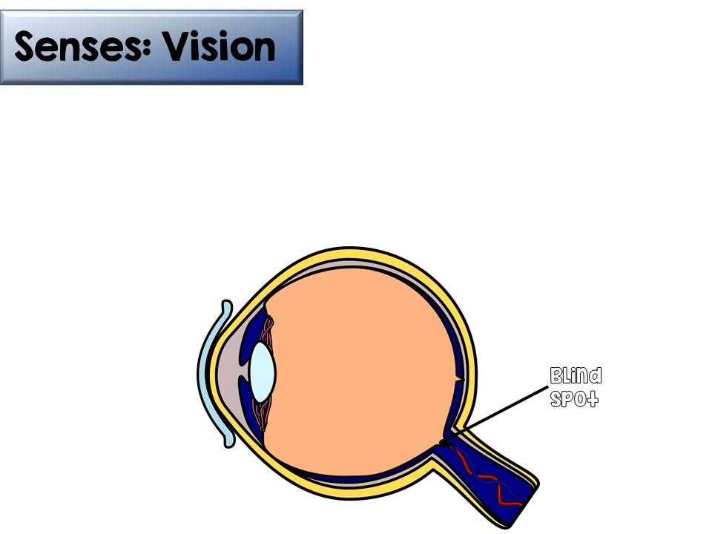
There are no photoreceptors where the optic nerve meets the eye. This is called a blind spot.
Because this blind spot affects different parts of each eye, it is not regularly noticed. The brain “fills in” the missing images.
© Gnature with Gnat 2018

Slide 55
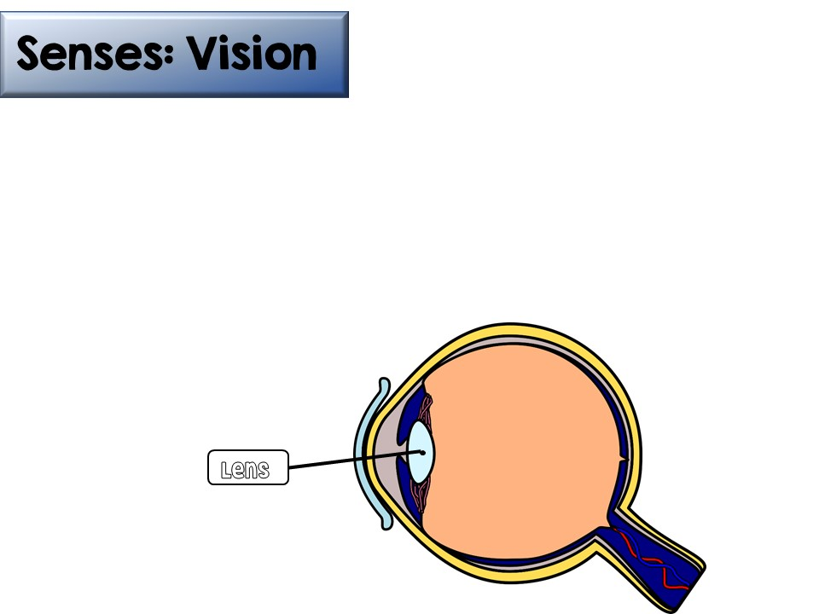
The lens is a semi-solid disc that directs light waves towards the retina.
It is controlled by ciliary muscles and suspensory ligaments.
These muscles and ligaments help bend or flatten the lens based on the distance of the image being viewed.
  The lens becomes less elastic with age, causing some adults to need corrective lenses to have difficulty focusing at certain distances.
© Gnature with Gnat 2018

Slide 56
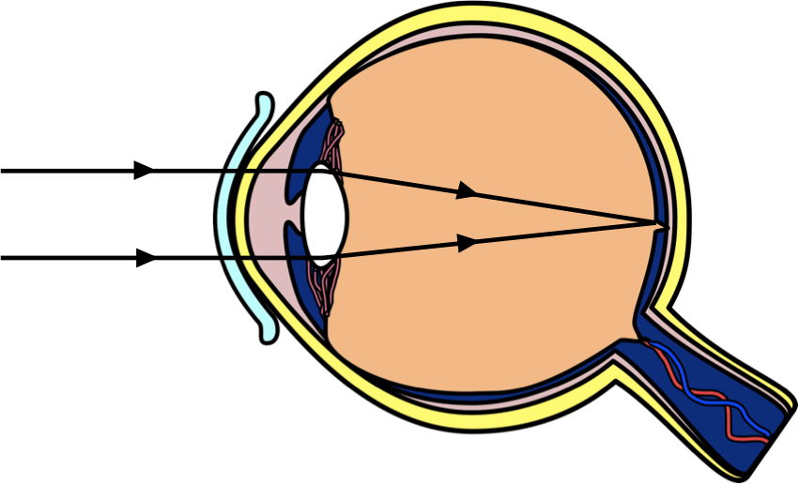
Senses: Vision
The lens is responsible for focusing the light on the retina, to be interpreted by the photoreceptors and sent to the brain.
© Gnature with Gnat 2018

Slide 57
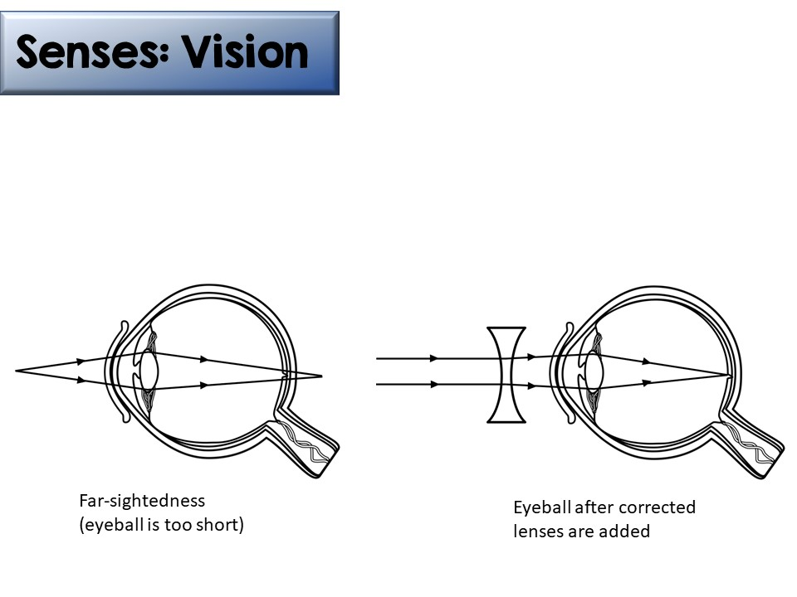
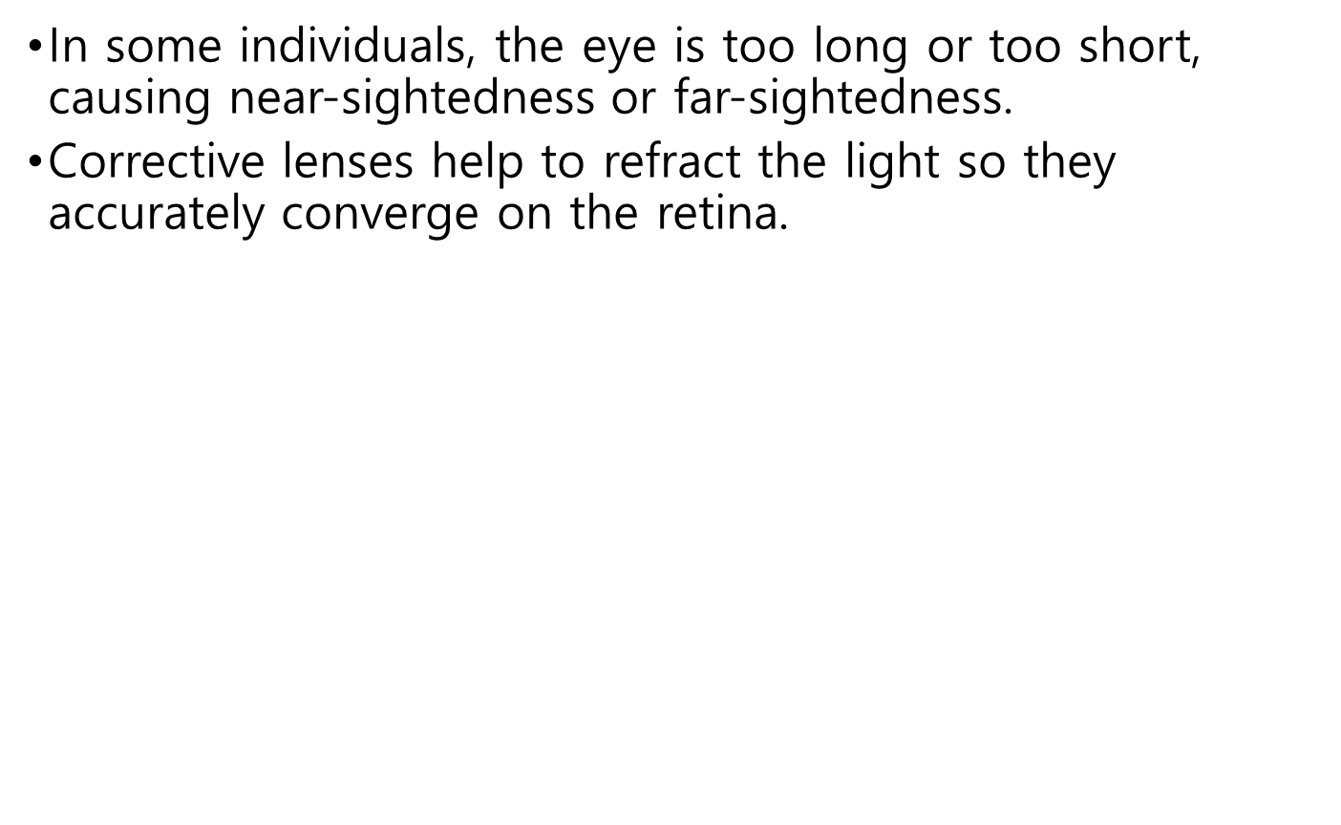
© Gnature with Gnat 2018

Slide 58
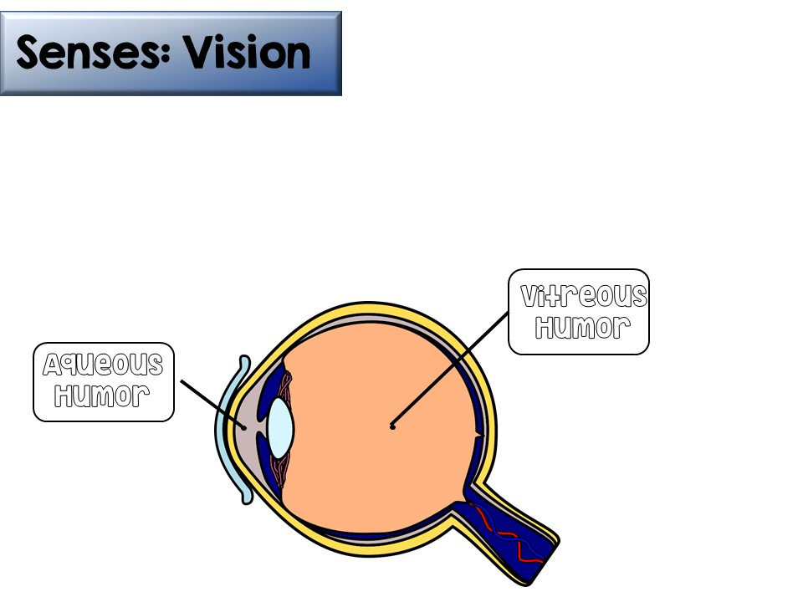
In front of the lens is a fluid called aqueous humor, which nourishes the cornea and behind the lens is the vitreous humor, which is a thick, jelly-like fluid that refracts light and fills the space between the lens and retina.

