Slide 1
The Hip Joint
E.Q. What is the structure of the hip joint?

Slide 2
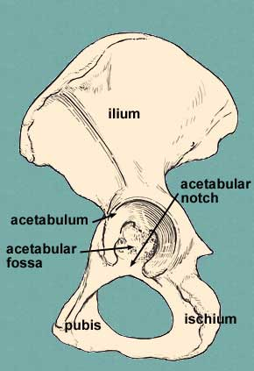
Bones
Ilium
Ischium
Pubis
Femur
(Sacrum)

Slide 3
3 Joints of the Pelvic Girdle
Pubic Symphysis
Sacroiliac (SI)
Acetabulum / Head of the Femur (Hip)

Slide 4
The Hip Joint
The hip joint is formed by the articulation of the head of the femur into the acetabulum of the hip.
ball-and-socket joint.
Synovial joint
Note: The acetabulum is formed by the pubis, ischium and ilium bones

Slide 5
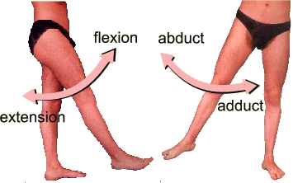
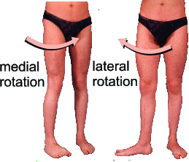
Movements
The hip joint is the most mobile joint in the lower limb. It is capable of flexion and extension, abduction and adduction, medial and lateral rotation and all of these in a circular motion- circumduction
second largest range of movement (second only to the shoulder) supports the weight of the body, arms and head.

