Slide 1
P.R.I.C.E.
Treatment of acute injuries

Slide 2
For Acute Injuries
Treatment for a sports injury will depend on how severe the injury is.
If an injury does not require medical treatment – for example, a mild sprain or strain – you can treat it by using PRICE therapy.

Slide 3
PRICE stands for protection, rest, ice, compression, and elevation.

Slide 4
Protection
protect the affected area from further injury – for example, by using a support.

Slide 5
Rest –
avoid exercise and reduce your daily physical activity. Using crutches or a walking stick may help if you cannot put weight on your ankle or knee.

Slide 6
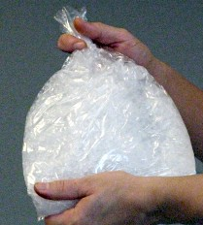
Ice –
Apply an ice pack
10–30 minutes (MAX)
Wrap the ice pack in a towel to avoid it directly touching the skin and causing ice burn.

Slide 7
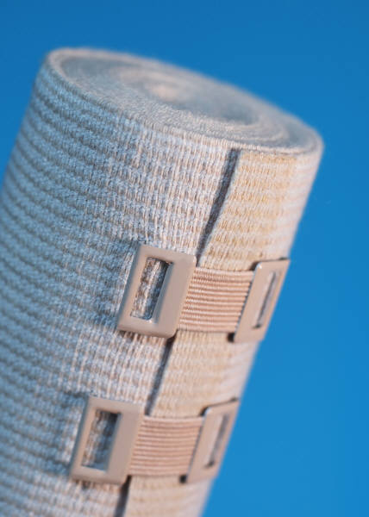
Compression –
use elastic compression bandages to limit swelling.

Slide 8
Elevation –
keep the injured leg, knee, arm, elbow or wrist raised above the level of the heart. This may also help to reduce swelling.

